Slide 2

Angular Unit testing

Slide 3
Agenda
What is Unit testing
Why Unit testing is important
Angular application configuration for unit testing debug and code coverage
Component unit testing with angular testing utilities
Testing Http Services

Slide 4
Angular – Unit Testing
What is Unit Testing?
Unit testing is a software development process in which the smallest testable parts of an application, called units, are individually and independently scrutinized for proper operation. Unit testing can be done manually but it is often automated.

Slide 5
Angular – Unit Testing
Why Unit testing is important
Unit testing Analyze the code behavior (expected and unexpected changes).
It behaves as a safeguard against breaking changes. One of the best ways to keep your project bug free is through a test suite.
Makes developers feel guilty free on their code changes.
It also reveals the design mistakes.

Slide 6

Angular – Unit Testing
Angular application configuration for unit testing debug and code coverage.
Configuration:
The Angular CLI downloads and install everything we need to test an Angular application with the Jasmine test framework.
When we create a component, directive, pipe etc. through Angular CLI, spec file will be created automatically with the default test suite.
Once we created a project through Angular CLI/ cloning from a remote repository, go to project root directory and run the below command to run the test suite.

Slide 7
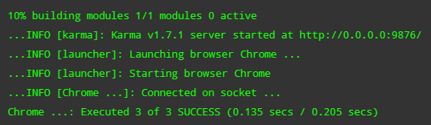
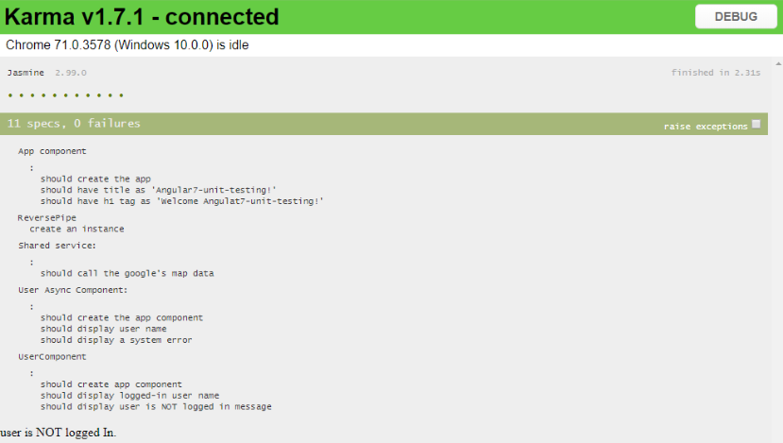
Angular – Unit Testing
And we see the below logs in the console.
Also, ng test opens up chrome window to view the success and failed test cases.

Slide 8
Angular – Unit Testing
Debug:
Debug specs in the browser in the same way that debug an application.
Reveal the karma browser window (hidden earlier).
Click the DEBUG button; it opens a new browser tab and re-runs the tests.
Open the browser’s “Developer Tools”.
Pick the “sources” section.
Open the app.component.spec.ts test file (Control/Command-P, then start typing the name of the file).
Set a breakpoint in the test.
Refresh the browser, and it stops at the breakpoint.

Slide 9
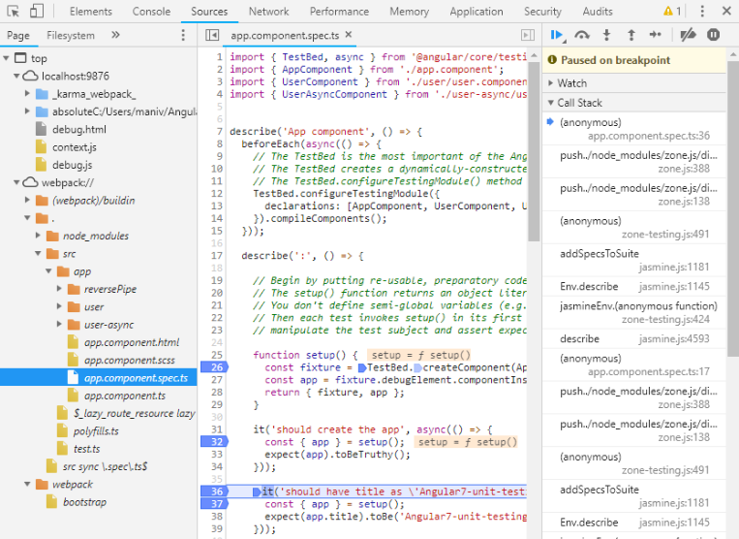
Angular – Unit testing
Diagram depicts how to debug.

Slide 10


Angular – Unit testing
Code coverage
If we want to create code-coverage reports every time we run the test suite, can set the following option in the CLI configuration file, angular.json:
(or) run the below command in the project root directory.

Slide 11
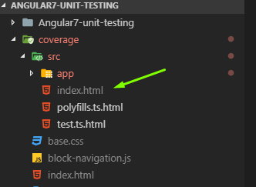
Angular – Unit Testing
Whenever test suite executed successfully, we will see a “coverage” folder in project root directory.

Slide 12
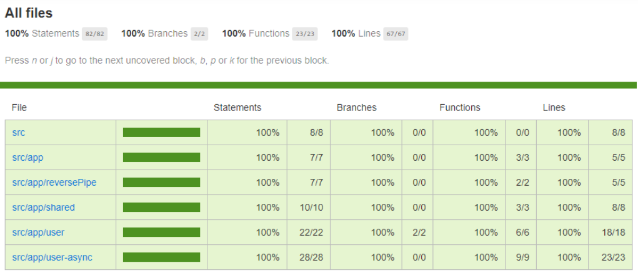
Angular – Unit Testing
Open the index.html file in any browser to view the test case coverage for all the files in the project.

Slide 13
Angular – Unit Testing
Component unit testing with angular testing utilities
What is TestBed
The TestBed is the most important of the Angular testing utilities. It creates a dynamically-constructed Angular test module that emulates an Angular @NgModule.TestBed.configureTestingModule() method takes a metadata object that can have most of the properties of an @NgModule.
The TestBed API consists of static class methods that either update or reference a global instance of the TestBed.

Slide 14
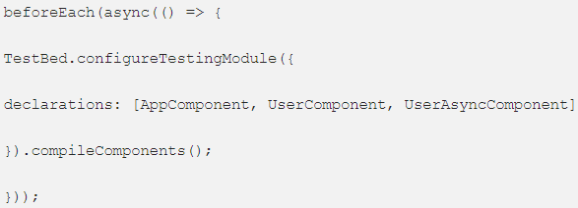
Angular – Unit Testing
Internally, all static methods cover methods of the current runtime TestBed instance, which is also returned by the getTestBed() function.
Call TestBed methods within a beforeEach() to ensure a fresh start before each individual test.

Slide 15
Angular – Unit Testing
What is a component fixture
The TestBed.createComponent<T> creates an instance of the component T and returns a strongly typed for that component.
The ComponentFixture properties and methods provide access to the component, its DOM representation, and aspects of its Angular environment.
The fixture methods cause Angular to perform certain tasks on the component tree. Call these methods to trigger Angular behavior in response to simulated user action.

Slide 16
Angular – Unit Testing
What is DebugElement
The DebugElement provides crucial insights into the component's DOM representation.
From the test root component’s DebugElement returned by fixture.debugElement, you can walk (and query) the fixture's entire element and component subtrees.

Slide 17
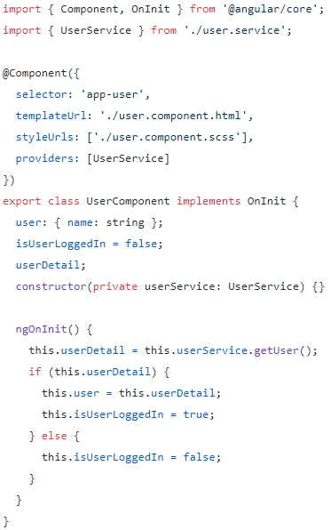
Angular – Unit Testing
Synchronous service unit test
Testing synchronous service which is injected in a component. Injecting the real service rarely works well as most dependent services are difficult to create and control.
User.component.ts

Slide 18
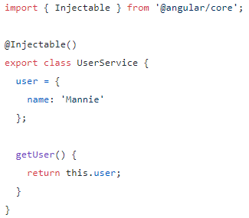
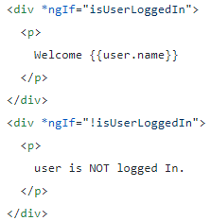
Angular – Unit testing
User.service.ts
User.component.html

Slide 19


Angular – Unit Testing
Injecting service in a spec file.
Spy the service and return the custom values.
Update the properties, run the change detection. We must tell the TestBed to perform data binding by calling fixture.detectChanges().

Slide 20
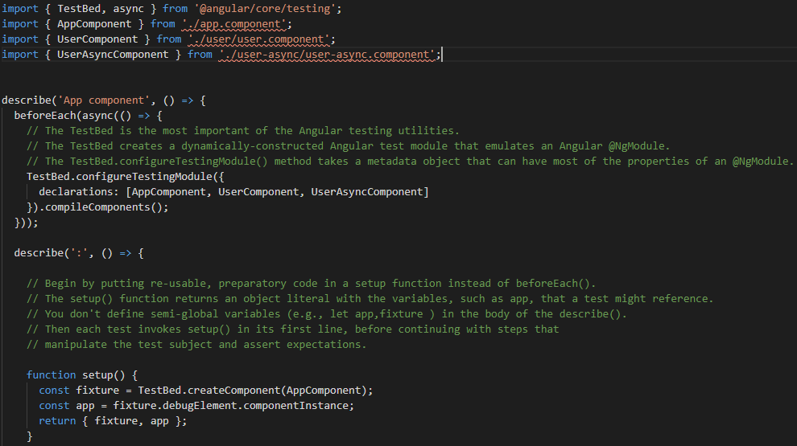
Angular – Unit Testing

Slide 21
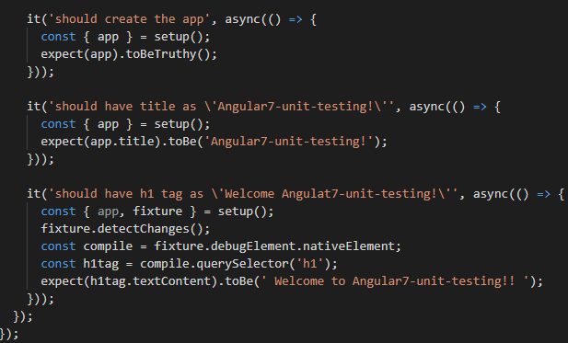
Angular – Unit Testing
User.component.spec.ts

Slide 22
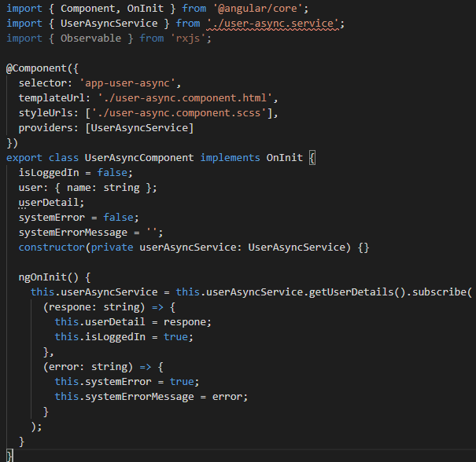
Angular – Unit Testing
Async service(Observables implementation) unit testing.
User-async.component.ts

Slide 23
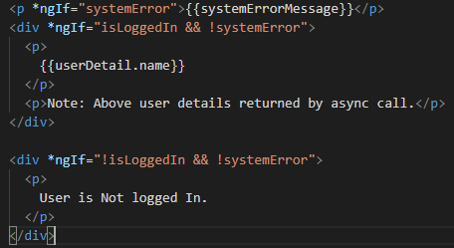
Angular – Unit Testing
User-async.component.html

Slide 24
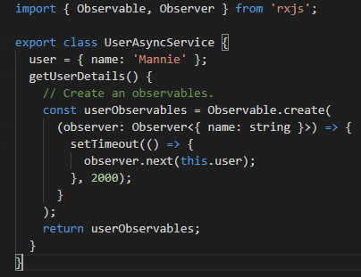
Angular – Unit Testing
Creating Async service using Observable, observable returns username after 2 milliseconds
User-async.service.ts

Slide 25
Angular – Unit Testing
tick, fakeAsync testing utilities are used to test Async service.
fakeAsync — wrap “it” with fakeAsync to create Async environment for test.it allows running Async task and it simulates like Async call running in the browser.
tick — Wait for Async calls finishes and successfully to access the data. Simulates the passage of time and the completion of pending asynchronous activities by flushing both timer and micro-task queues within the fakeAsync test zone.

Slide 26
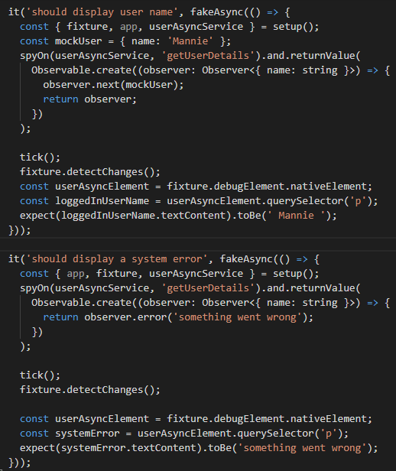
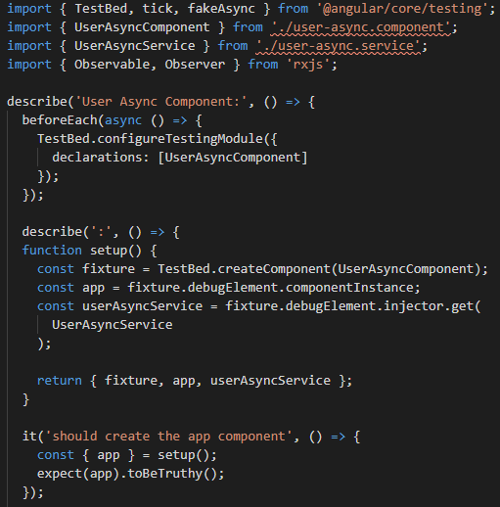
Angular – Unit Testing
user-async.component.spec.ts

Slide 27
Angular – Unit Testing
Testing HTTP service
Data services that make HTTP calls to remote servers typically inject and delegate to the Angular HTTPClient service for XMLHttpRequest calls.
fdescribe and fit ( skip the test or run only specific tests)
fdescribe to run the test for a spec file or a test suite. It skips all other files or runs test for the specified file.

Slide 28
Angular – Unit Testing
Why put spec file next to the file it tests
It’s a good idea to put unit test spec files in the same folder as the application source code files that they test:
Such tests are easy to find.
You see at a glance if a part of application lacks tests.
Nearby tests can reveal how a part works in context.
When you move the source (inevitable), remember to move the test.
When you rename the source file (inevitable), remember to rename the test file.

Slide 29
THANK YOU

